Slide 1
Chapter #9: Finite State
Machine Optimization

Slide 2
Chapter Outline
Procedures for optimizing implementation of an FSM
State Reduction
State Assignment
Computer Tools for State Assignment: Nova, Mustang, Jedi
Choice of Flipflops
FSM Partitioning

Slide 3
Motivation
Basic FSM Design Procedure:
(1) Understand the problem
(2) Obtain a formal description
(3) Minimize number of states
(4) Encode the states
(5) Choose FFs to implement state register
(6) Implement the FSM
This
Chapter!
Next Chapter

Slide 4
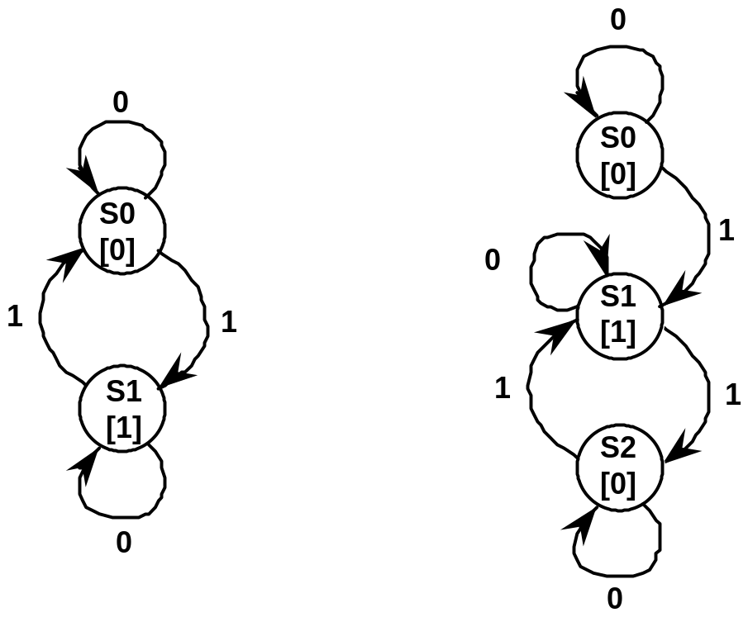
Motivation
State Reduction
Odd Parity Checker: two alternative state diagrams
Identical output behavior on all input strings
FSMs are equivalent, but require different implementations
Design state diagram without concern for # of states,
Reduce later

Slide 5
Motivation
State Reduction (continued)
Implement FSM with fewest possible states
Least number of flipflops
Boundaries are power of two number of states
Fewest states usually leads to more opportunities for don't cares
Reduce the number of gates needed for implementation

Slide 6
State Reduction
Goal
Identify and combine states that have equivalent behavior
Equivalent States: for all input combinations, states transition
to the same or equivalent states
Odd Parity Checker: S0, S2 are equivalent states
Both output a 0
Both transition to S1 on a 1 and self-loop on a 0
Algorithmic Approach
Start with state transition table
Identify states with same output behavior
If such states transition to the same next state, they are equivalent
Combine into a single new renamed state
Repeat until no new states are combined

Slide 7
State Reduction
Row Matching Method
Example FSM Specification:
Single input X, output Z
Taking inputs grouped four at a time, output 1 if last four inputs
were the string 1010 or 0110
Example I/O Behavior:
X = 0010 0110 1100 1010 0011 . . .
Z = 0000 0001 0000 0001 0000 . . .
Upper bound on FSM complexity:
Fifteen states (1 + 2 + 4 + 8)
Thirty transitions (2 + 4 + 8 + 16)
sufficient to recognize any binary string of length four!

Slide 8
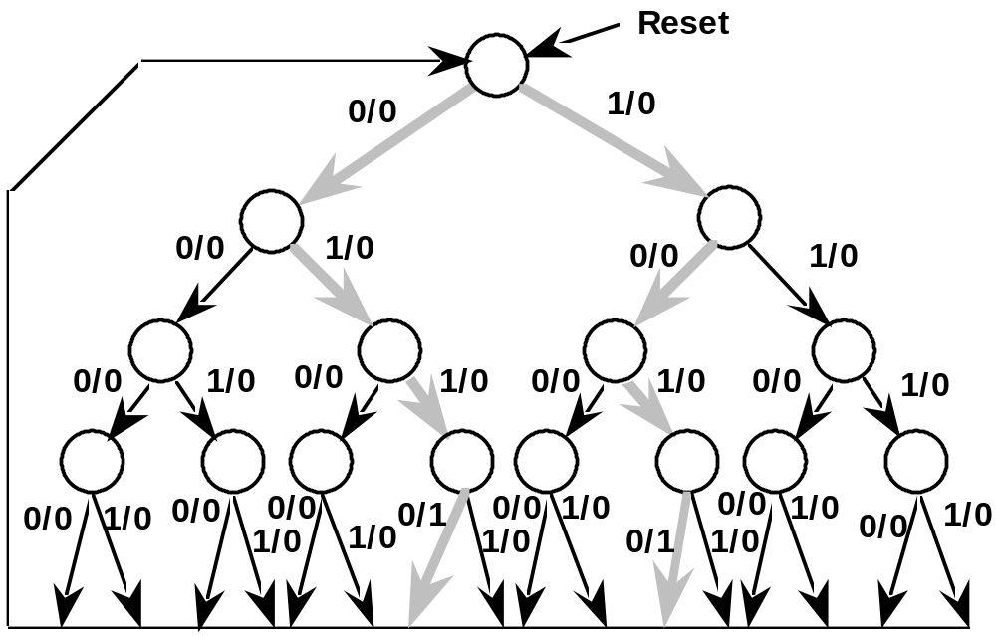
State Reduction
Row Matching Method
State Diagram for Example FSM:

Slide 9
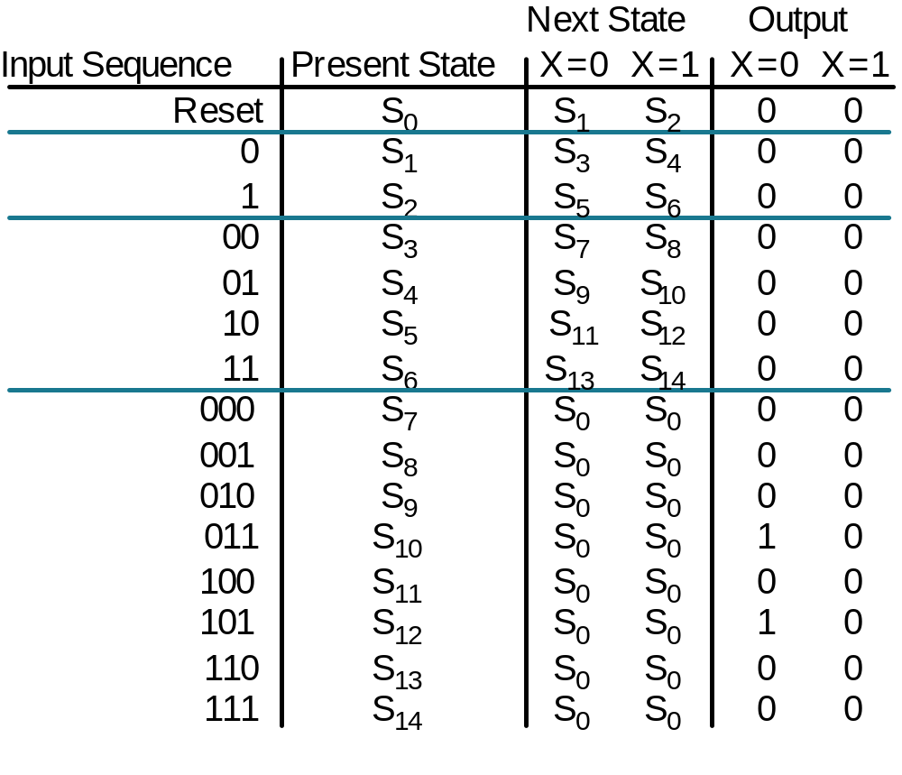
State Reduction
Row Matching Method
Initial State Transition Table:

Slide 10
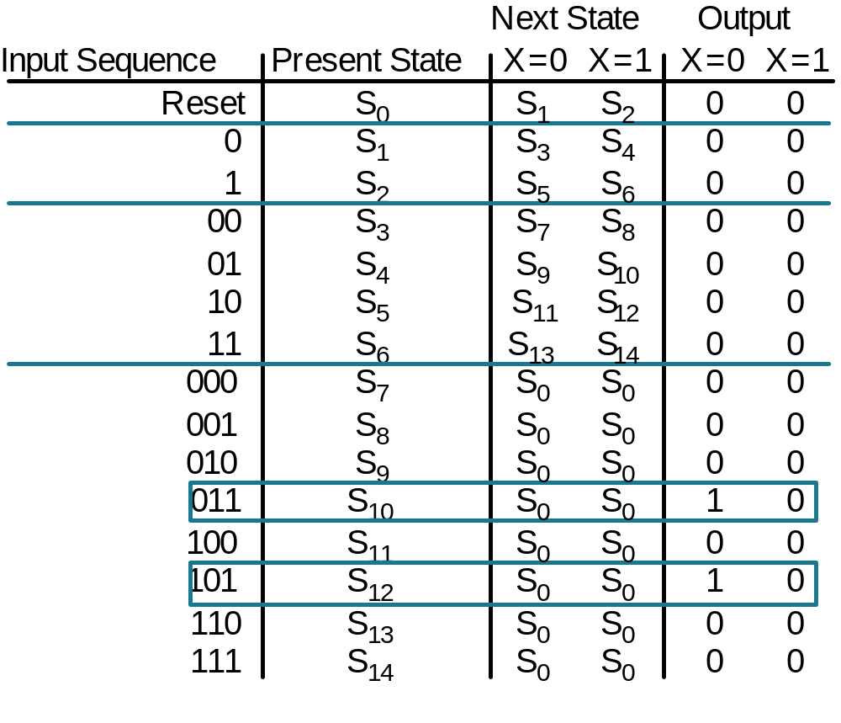
State Reduction
Row Matching Method
Initial State Transition Table:

Slide 11
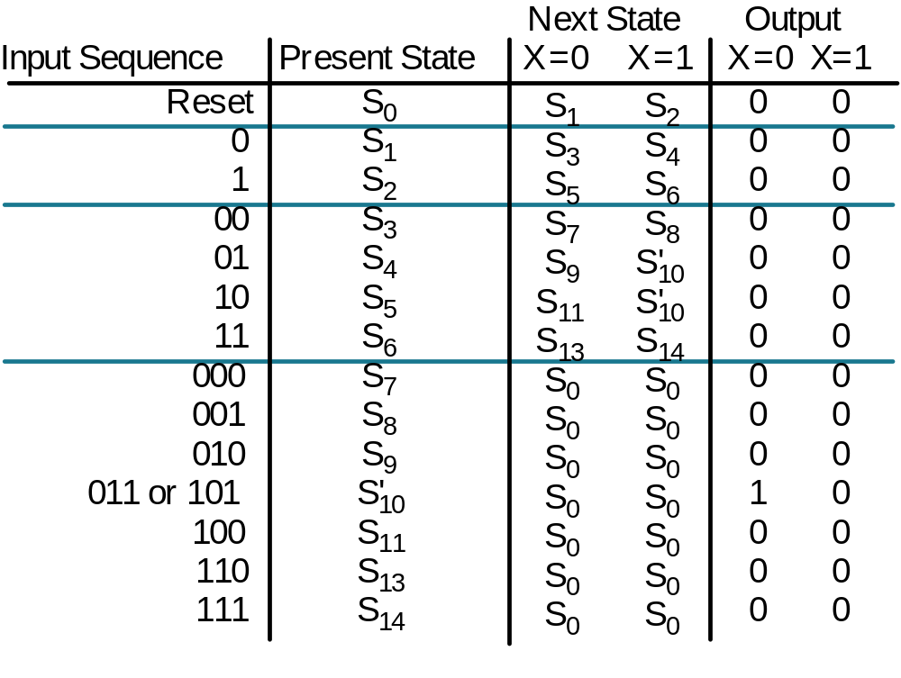
State Reduction
Row Matching Method

Slide 12
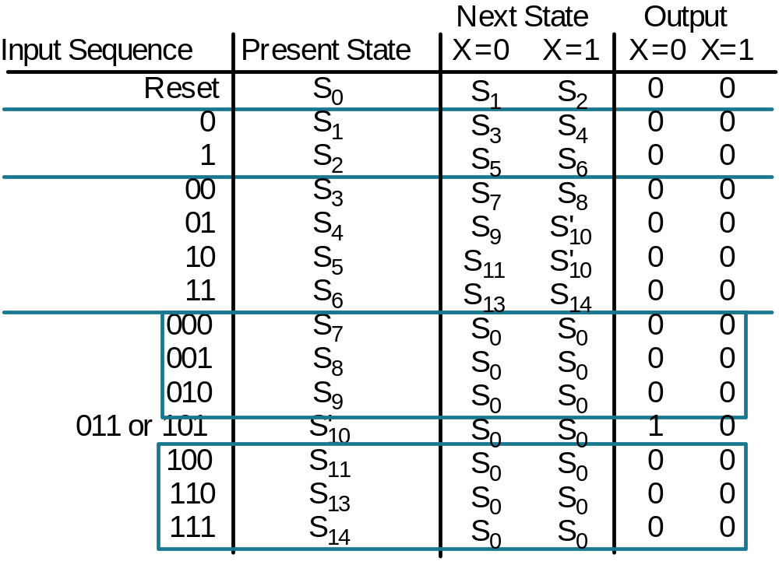
State Reduction
Row Matching Method

Slide 13
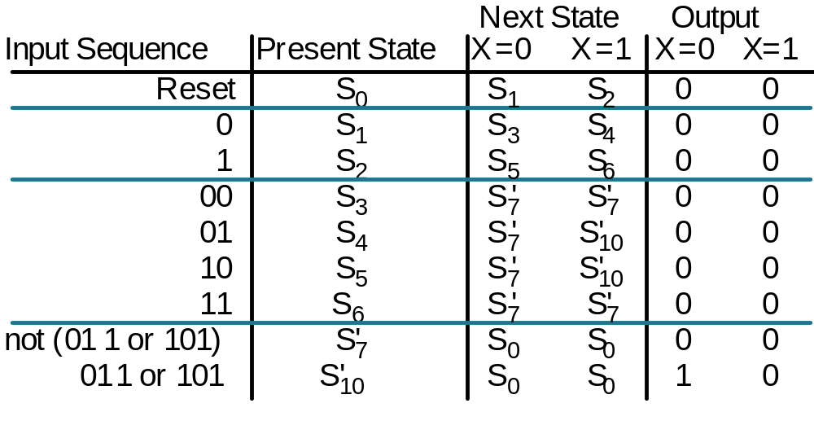
State Reduction
Row Matching Method

Slide 14
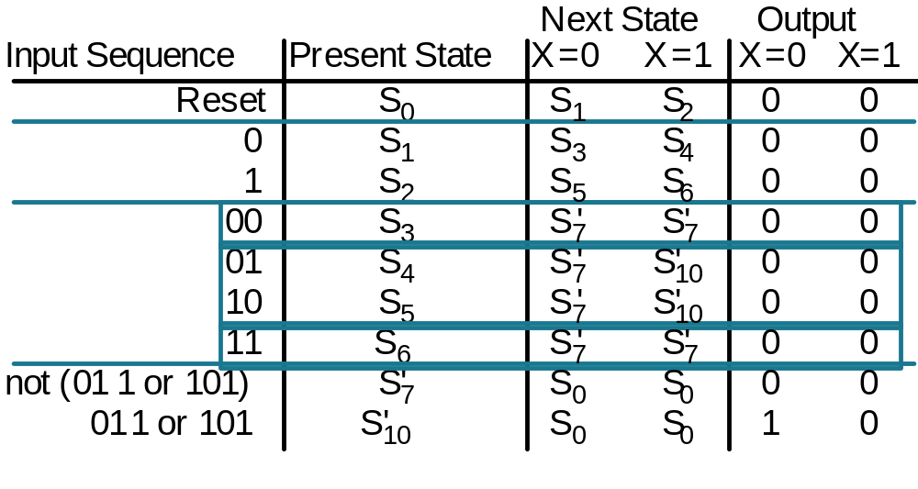
State Reduction
Row Matching Method

Slide 15
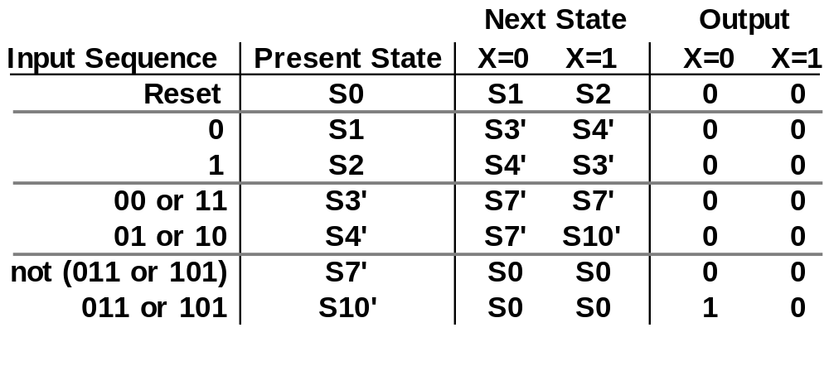
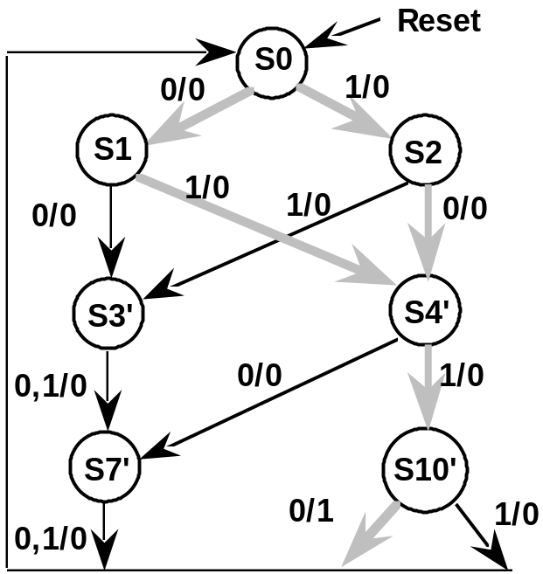
State Reduction
Row Matching Method
Final Reduced
State Transition Table
Corresponding State
Diagram

Slide 16
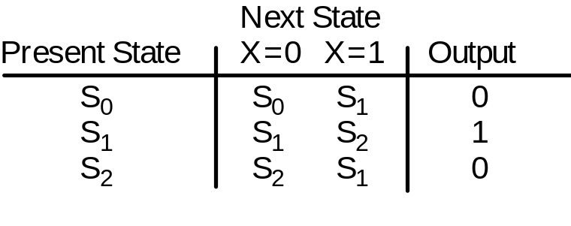
State Reduction
Row Matching Method
Straightforward to understand and easy to implement
Problem: does not allows yield the most reduced state table!
Example: 3 State Odd Parity Checker
No way to combine states S0 and S2
based on Next State Criterion!

Slide 17
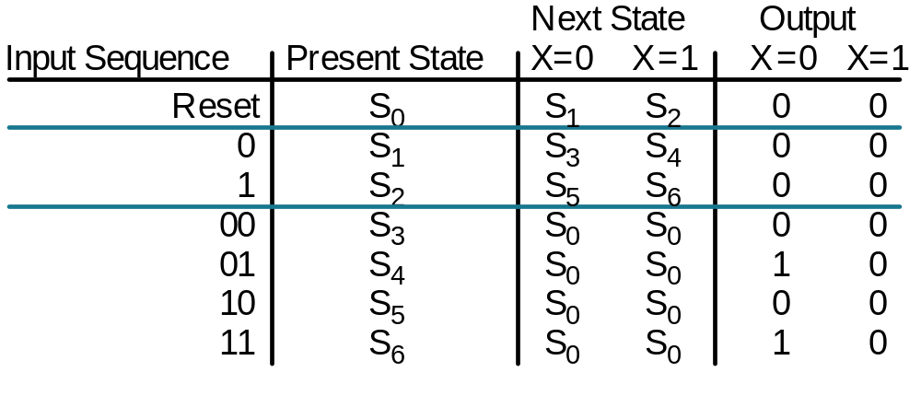
State Reduction
Implication Chart Method
New example FSM:
Single input X, Single output Z
Output a 1 whenever the serial sequence 010 or 110 has been
observed at the inputs
State transition table:

Slide 18
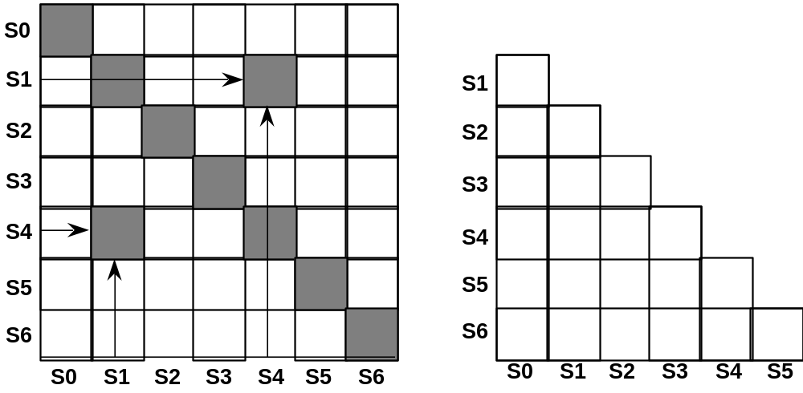
S2
Implication Chart Method
Enumerate all possible combinations of states taken two at a time
Next States
Under all
Input
Combinations
Naive Data Structure:
Xij will be the same as Xji
Also, can eliminate the diagonal
Implication Chart

Slide 19
State Reduction
Implication Chart
Filling in the Implication Chart
Entry Xij ?Row is Si, Column is Sj
Si is equivalent to Sj if outputs are the same and
next states are equivalent
Xij contains the next states of Si, Sj which must be equivalent if
Si and Sj are equivalent
If Si, Sj have different output behavior, then Xij is crossed out
Example:
S0 transitions to S1 on 0, S2 on 1;
S1 transitions to S3 on 0, S4 on 1;
So square X<0,1> contains entries S1-S3 (transition on zero)
S2-S4 (transition on one)
S1-S3
S2-S4
S0
S1

Slide 20
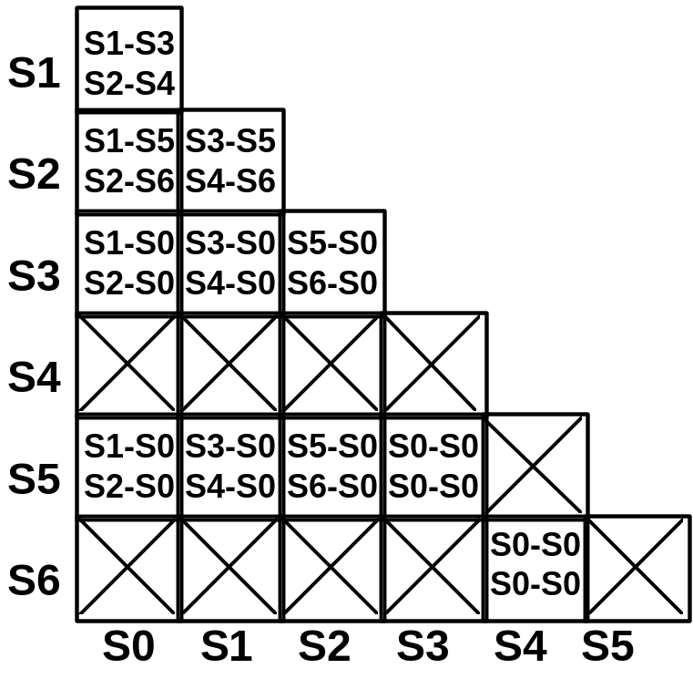
State Reduction
Implication Chart Method
S2 and S4
have different
I/O behavior
This implies that
S1 and S0 cannot
be combined
Starting Implication Chart

Slide 21
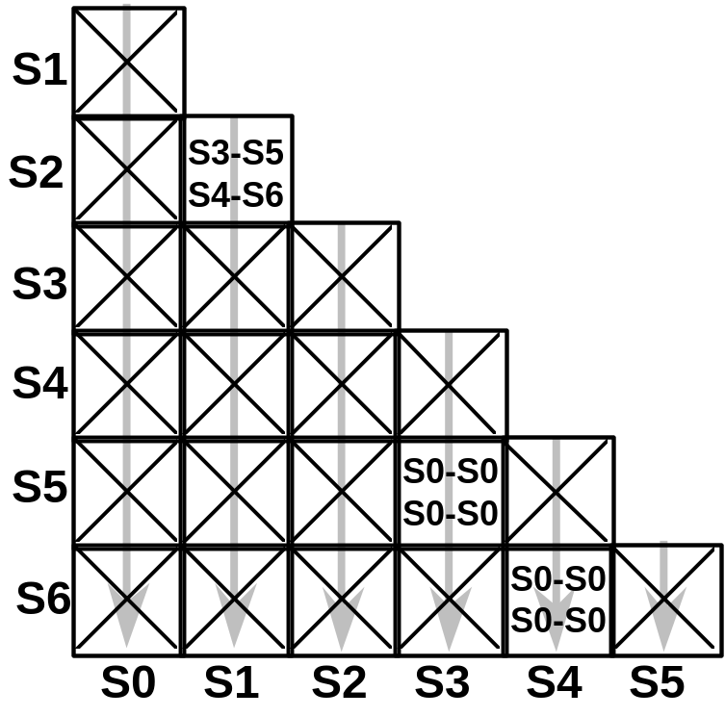
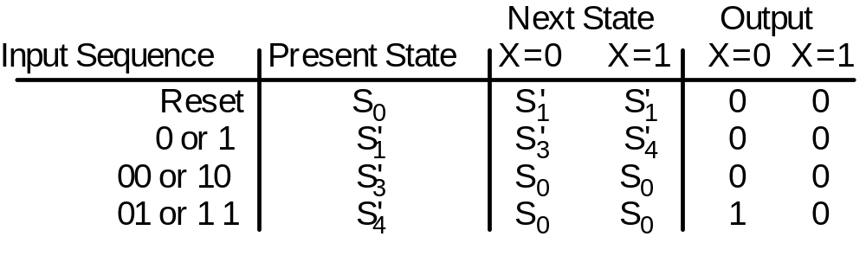
State Reduction
Implication Chart Method
Results of First Marking Pass
Second Pass Adds No New Information
S3 and S5 are equivalent
S4 and S6 are equivalent
This implies that S1 and S2 are too!
Reduced State
Transition Table

Slide 22
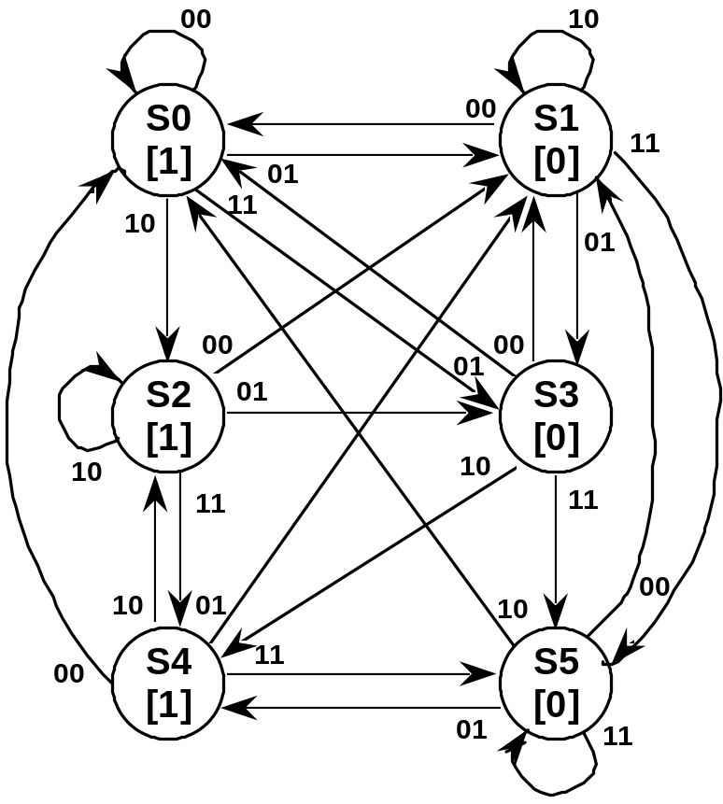
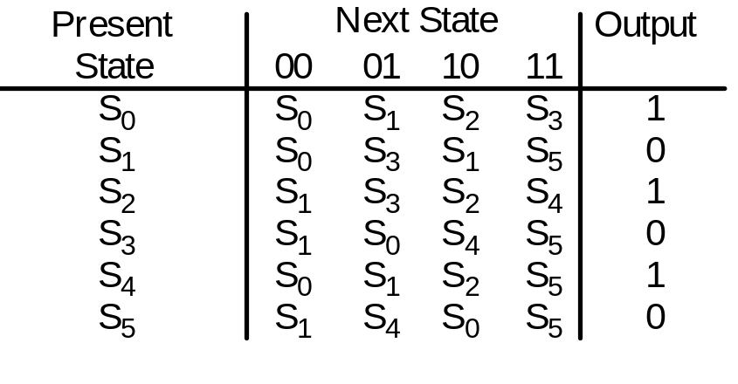
State Reduction
Multiple Input State Diagram Example
Symbolic State Diagram
State Diagram

Slide 23
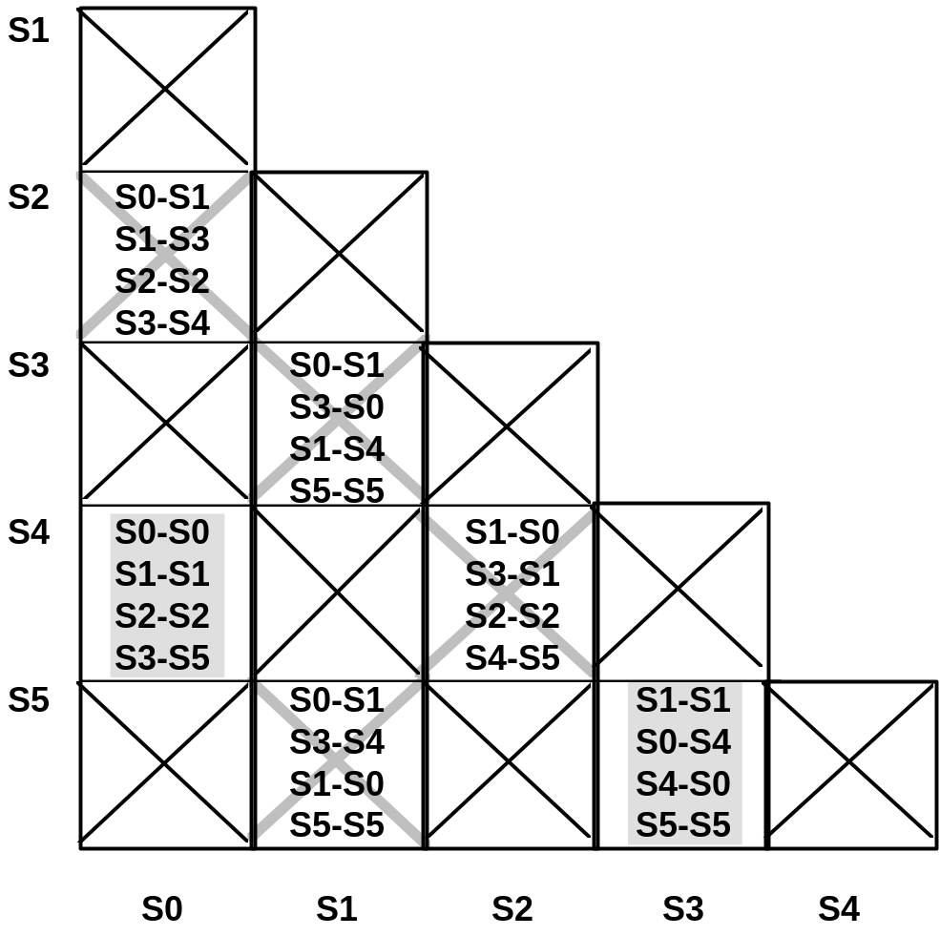
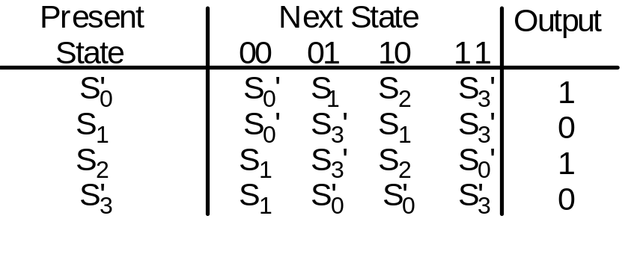
State Reduction
Multiple Input Example
Minimized State Table
Implication Chart

Slide 24
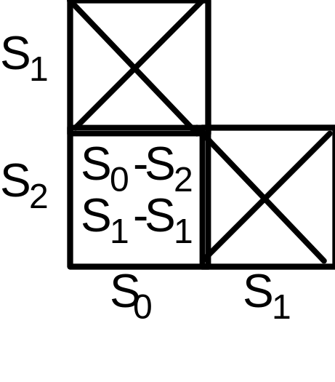
State Reduction
Implication Chart Method
Does the method solve the problem with the odd parity checker?
Implication Chart
S0 is equivalent to S2
since nothing contradicts this assertion!

Slide 25
State Reduction
Implication Chart Method
The detailed algorithm:
1. Construct implication chart, one square for each combination of states taken two at a time
2. Square labeled Xi,j, if outputs differ than square gets "X". Otherwise write down implied state pairs for all input combinations
3. Advance through chart top-to-bottom and left-to-right. If square Xi,j contains next state pair Sm, Sn and that pair labels a square already labeled "X", then Xi,j is labeled "X".
4. Continue executing Step 3 until no new squares are marked with "X".
5. For each remaining unmarked square Xi,j, then Si and Sj are equivalent.

Slide 26
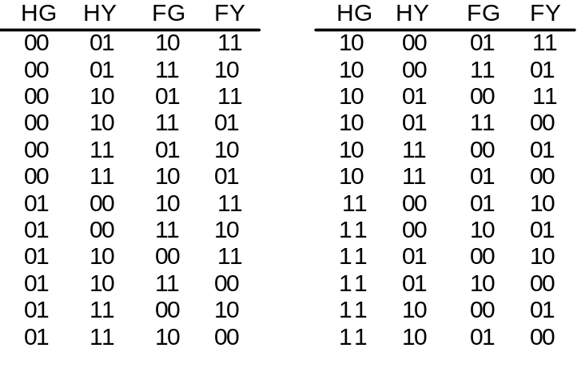
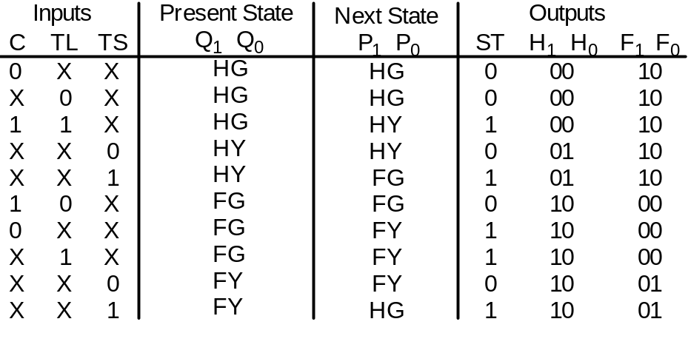
State Assignment
When FSM implemented with gate logic, number of gates will depend on
mapping between symbolic state names and binary encodings
4 states = 4 choices for first state, 3 for second, 2 for third, 1 for last
= 24 different encodings (4!)
Example for State Assignment: Traffic Light Controller
24 state assignments
for the traffic light
controller
Symbolic State Names: HG, HY, FG, FY
Green=00, Yellow=01, Red=10

Slide 27
State Assignment
Some Sample Assignments for the Traffic Light Controller
Espresso input format:
.i 5
.o 7
.ilb c tl ts q1 q0
.ob p1 p0 st h1 h0 f1 f0
.p 10
0-- HG HG 00010
-0- HG HG 00010
11- HG HY 10010
--0 HY HY 00110
--1 HY FG 10110
10- FG FG 01000
0-- FG FY 11000
-1- FG FY 11000
--0 HY FY 01001
--1 HY HG 11001
.e
Two assignments: HG = 00, HY = 01, FG = 11, FY = 10
HG = 00, HY = 10, FG = 01, FY = 11

Slide 28
State Assignment
Random Assignments Evaluated with Espresso
.i 5
.o 7
.ilb c tl ts q1 q0
.ob p1 p0 st h1 h0 f1 f0
.p 9
11-00 0110000
10-11 1101000
--101 1010000
--010 1001001
---01 0100100
--110 0011001
---0- 0000010
0--11 1011000
-1-11 1011000
.e
.i 5
.o 7
.ilb c tl ts q1 q0
.ob p1 p0 st h1 h0 f1 f0
.p 8
11-0- 1010000
--010 1000100
0--01 1010000
--110 0110100
--111 0011001
----0 0000010
---01 0101000
--011 1101001
.e
26 literals
9 unique terms
several 5 and 4
input gates
13 gates total
21 literals
8 unique terms
no 5 input gates, 2 4 input gates
14 gates total

Slide 29
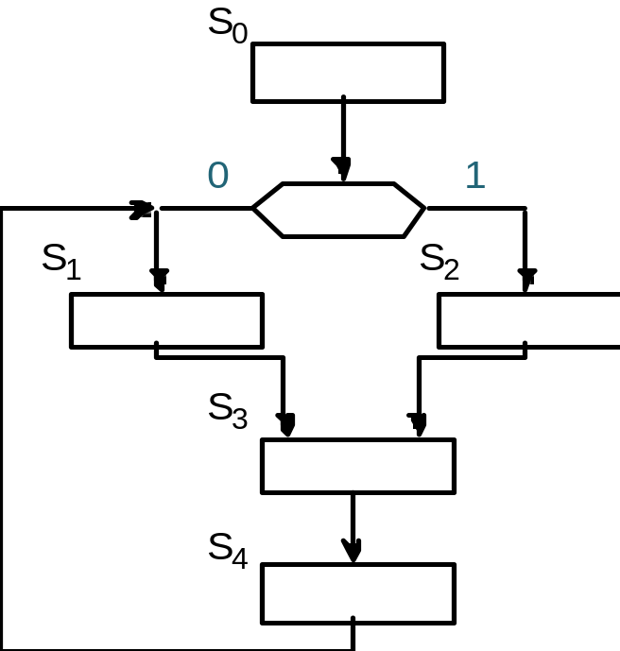
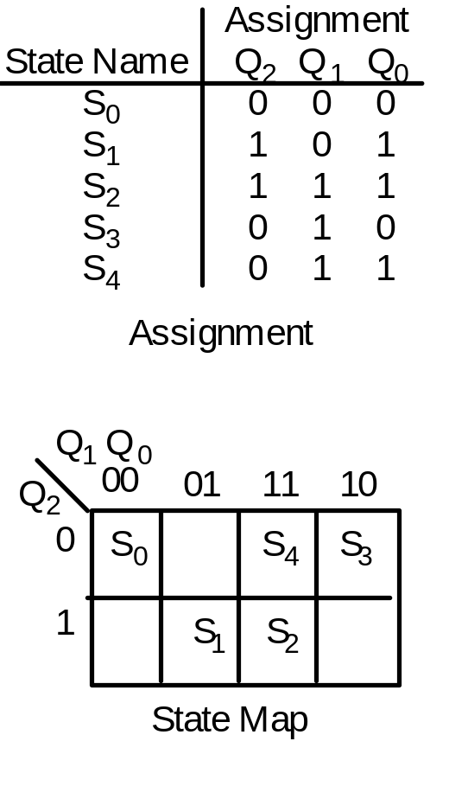
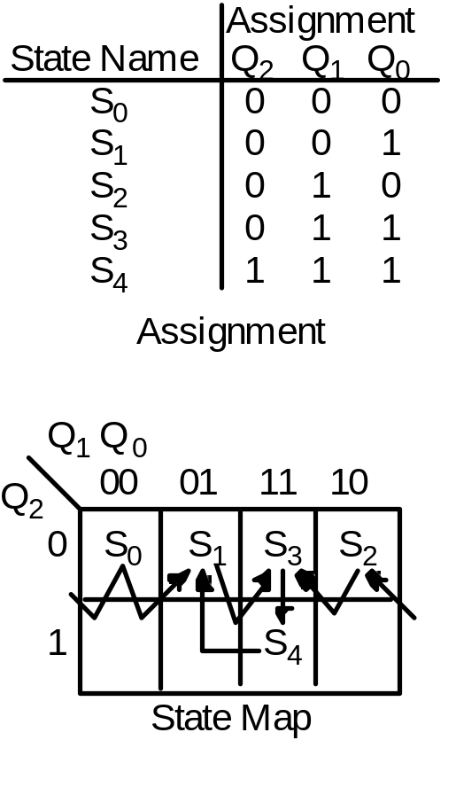
State Assignment
Pencil & Paper Heuristic Methods
State Maps: similar in concept to K-maps
If state X transitions to state Y, then assign "close" assignments
to X and Y

Slide 30
State Assignment
Paper and Pencil Methods
Minimum Transition Distance Criterion
First Assignment
Bit Changes
2
3
3
2
1
2
Second Assignment
Bit Changes
1
1
1
1
1
2
Transition
S0 to S1:
S0 to S2:
S1 to S3:
S2 to S3:
S3 to S4:
S4 to S1:
13
7
This heuristic is not likely to achieve the best assignment!
E.g., traffic light controller: HG = 00, HY = 01, FG = 11, FY = 10
yields minimum transition distance, but turned out
not best assignment as shown in 9-28!

Slide 31
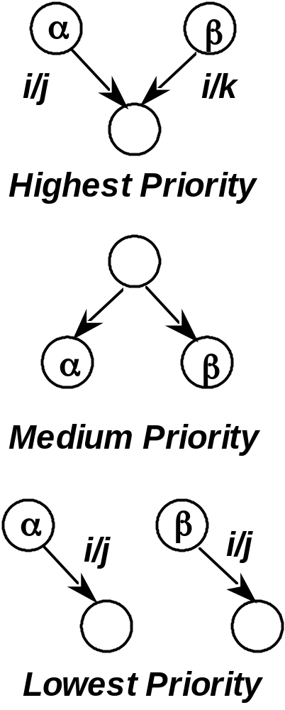
State Assignment
Paper & Pencil Methods
Alternative heuristics based on input and output behavior as well
as transitions:
Adjacent assignments to:
states that share a common next state
for a given input
(group 1's in next state map)
states that share a common ancestor state
(group 1's in next state map)
states that have common output behavior
(group 1's in output map)

Slide 32
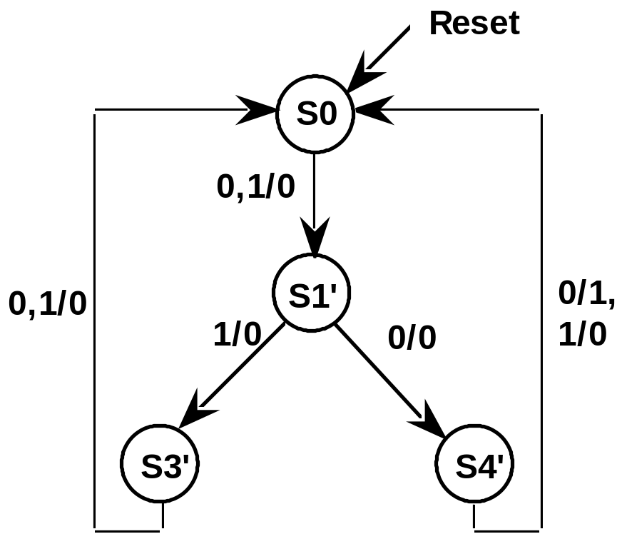
State Assignment
Pencil and Paper Methods
Example: 3-bit Sequence Detector
Highest Priority: (S3', S4')
Medium Priority: (S3', S4')
Lowest Priority:
0/0: (S0, S1', S3')
1/0: (S0, S1', S3', S4')

Slide 33
State Assignment
Paper and Pencil Methods
Q0 Q1 | 0 | 1
0 | S0 | S1'
1 | S3' | S4'
Reset State = 00
Q0 Q1 | 0 | 1
0 | S0 | S3'
1 | S1' | S4'
Highest Priority Adjacency
Not much difference in these two
assignments

Slide 34
State Assignment
Paper & Pencil Methods
Another Example: 4 bit String Recognizer
Highest Priority: (S3', S4'), (S7', S10')
Medium Priority:
(S1, S2), 2x(S3', S4'), (S7', S10')
Lowest Priority:
0/0: (S0, S1, S2, S3', S4', S7')
1/0: (S0, S1, S2, S3', S4', S7')

Slide 35
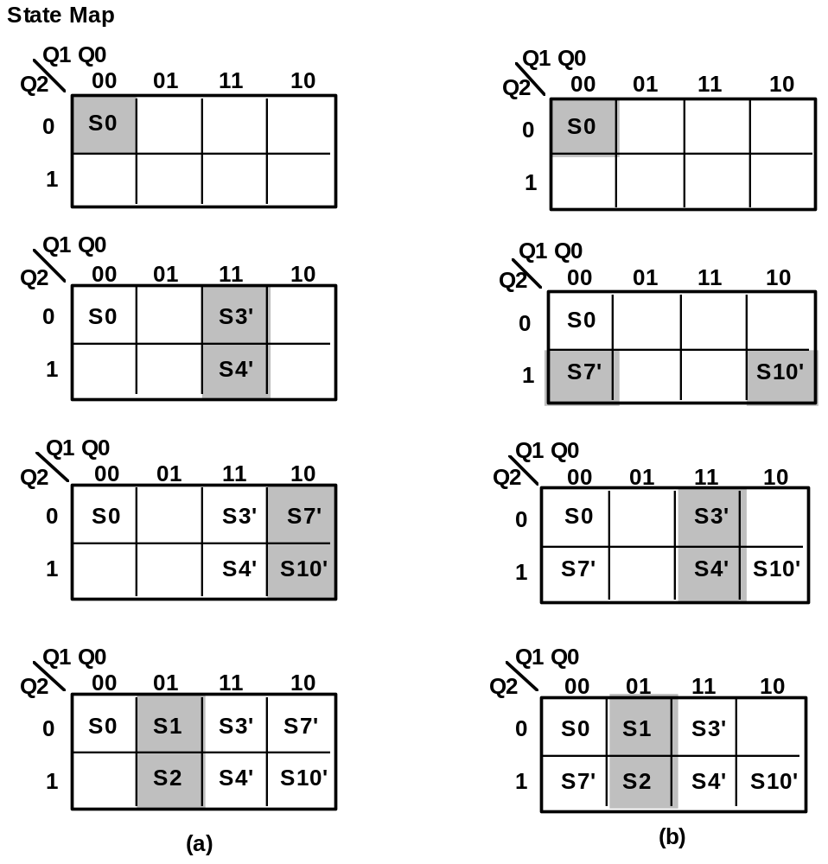
State Assignment
Paper & Pencil Methods
00 = Reset = S0
(S1, S2), (S3', S4'), (S7', S10')
placed adjacently

Slide 36
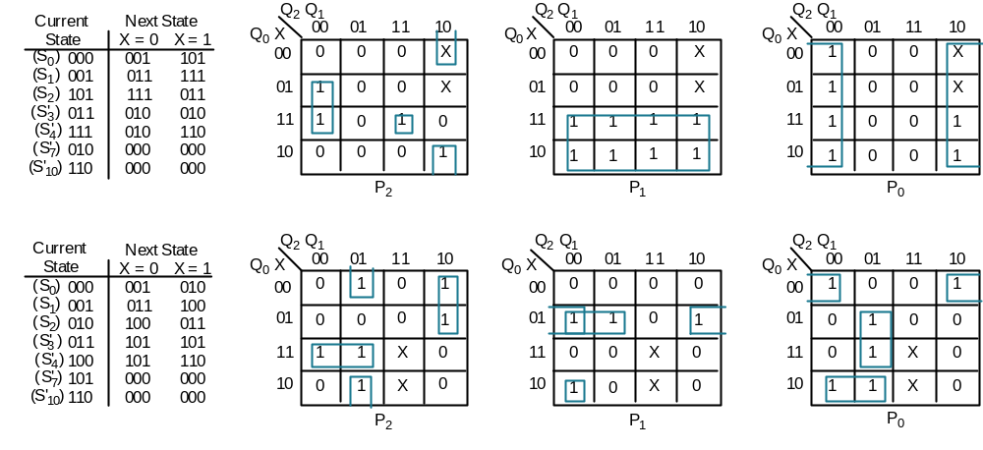
State Assignment
Effect of Adjacencies on Next State Map (Q1,Q2,Q3 → P1,P2,P3)
(a) in the previous slide
First encoding exhibits a better clustering of 1's in the next state map

Slide 37
State Assignment
One Hot Encodings to reduce next-state and output logic complexity
n states encoded in n flipflops
HG = 0001
HY = 0010
FG = 0100
FY = 1000
Complex logic for
discrete gate implementation
.i 7
.o 9
.ilb c tl ts q3 q2 q1 q0
.ob p3 p2 p1 p0 st h1 h0 f1 f0
.p 10
0-- 0001 0001 00010
-0- 0001 0001 00010
11- 0001 0010 10010
--0 0010 0010 00110
--1 0010 0100 10110
10- 0100 0100 01000
0-- 0100 1000 11000
-1- 0100 1000 11000
--0 0010 1000 01001
--1 0010 0001 11001
.e
.i 7
.o 9
.ilb c tl ts q3 q2 q1 q0
.ob p3 p2 p1 p0 st h1 h0 f1 f0
.p 8
10-0100 010001000
11-0001 001010010
-0-0001 000100010
0--0001 000100010
0--0100 100011000
-1-0100 100011000
--00010 101001111
--10010 010111111
.e
Espresso Inputs
Espresso Outputs

Slide 38
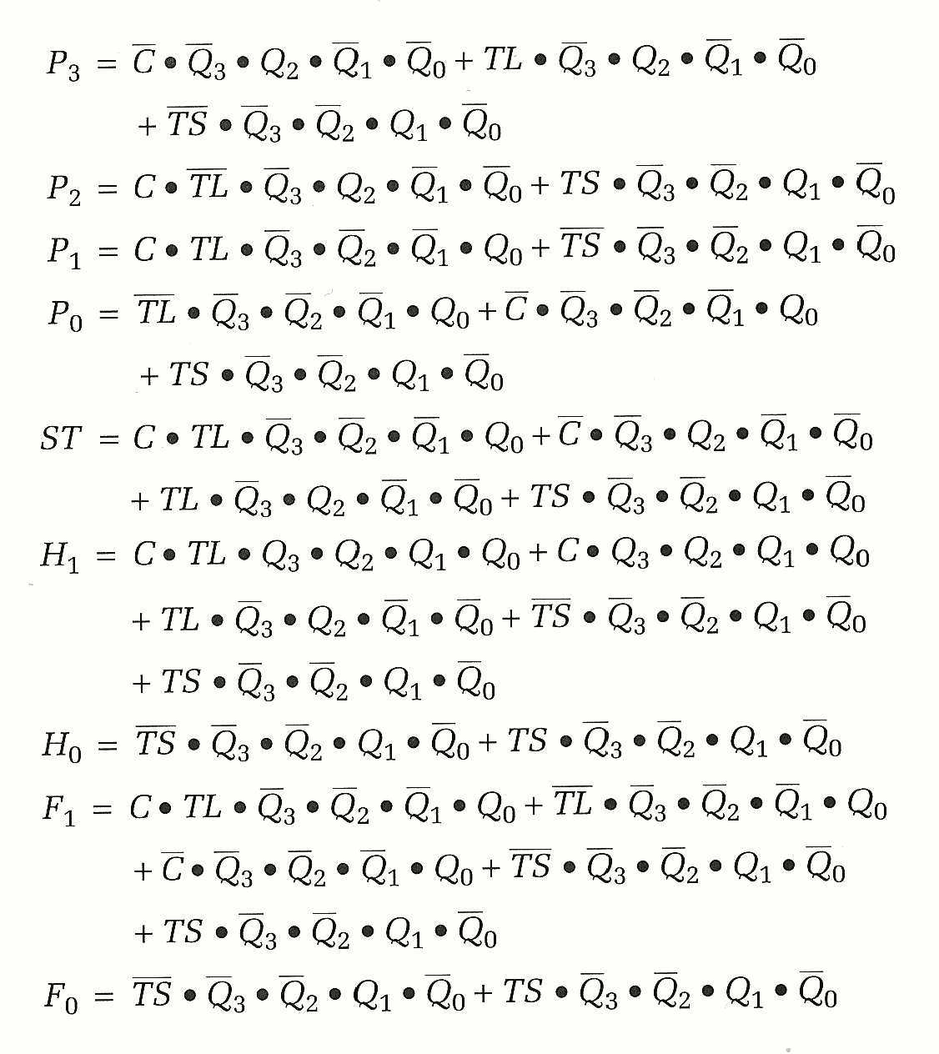
State Assignment
One Hot Encoding Results:
Yields eight product terms
cf. P.9-28
But, all the terms are too complicated with many literals
Could be OK if PLA-based design used

Slide 39
State Assignment
Computer-Based Methods
NOVA: State Assignment for 2-Level Circuit Networks
Input Constraints: states with same i/o mapped to same next state
Output Constraints: states which are successors of same predecessor
NOVA Input File for the Traffic Light Controller
inputs current_state next_state outputs
0-- HG HG 00010
-0- HG HG 00010
11- HG HY 10010
--0 HY HY 00110
--1 HY FG 10110
10- FG FG 01000
0-- FG FY 11000
-1- FG FY 11000
--0 FY FY 01001
--1 FY HG 11001
nova -e <encoding strategy> -t <nova input file>

Slide 40
State Assignment
Computer-Based Methods
Greedy: satisfy as many input constraints as possible
Hybrid: satisfy input constraints, more sophisticated improvement
strategy
I/O Hybrid: satisfy both input and output constraints
Exact: satisfy ALL input conditions
Input Annealing: like hybrid, but uses an even improvement strategy
1-Hot: uses a 1-hot encoding
Random: uses a randomly generated encoding

Slide 41
State Assignment
Computer-Based Methods
HG
00
00
11
00
01
11
HY
11
11
10
01
10
00
FG
01
10
01
11
11
01
FY
10
01
00
10
10
10
# of Product Terms
9
9
10
9
9
9
Greedy (-e ig):
Hybrid (-e ih):
Exact (-e ie):
IO Hybrid (-e ioh):
I Annealing (-e ia):
Random (-e r):
-z HG on the command line forces NOVA to assign 00 to state HG

Slide 42
State Assignment
Computer Based Methods
More NOVA Examples:
3-bit Recognizer
- S0 S1 0
0 S1 S3 0
1 S1 S4 0
- S3 S0 0
0 S4 S0 1
1 S4 S0 0
S0 S1' S3' S4' terms
Greedy: 00 01 11 10 4
Hybrid: 00 01 10 11 4
Exact: 00 01 10 11 4
IO Hyb: 00 10 01 11 4
I Ann: 00 01 11 10 4
Random: 00 11 10 01 4

Slide 43
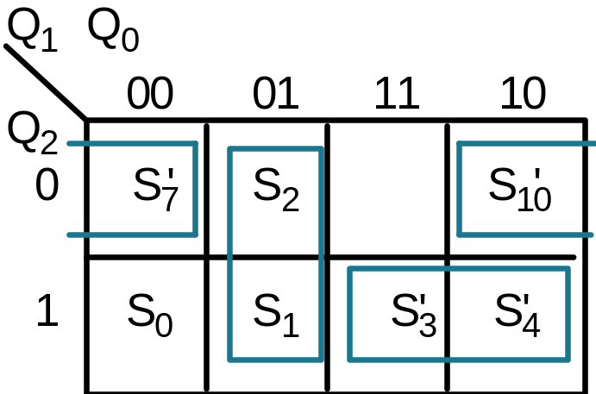
State Assignment
Computer Based Methods
More NOVA Examples:
4-bit Recognizer
0 S0 S1 0
1 S0 S2 0
0 S1 S3 0
1 S1 S4 0
0 S2 S4 0
1 S2 S3 0
- S3 S7 0
0 S4 S7 0
1 S4 S7 0
- S7 S0 0
0 S10 S0 1
1 S10 S0 0
Same adjacencies as
the heuristic method
S0 S1 S2 S3' S4' S7' S10' terms
Greedy: 100 110 010 011 111 000 001 7
Hybrid: 101 110 111 001 011 000 010 7
Exact: 101 110 111 001 011 000 010 7
IO Hyb: 110 011 001 100 101 000 010 7
I Ann: 100 101 001 111 110 000 010 6
Rand: 011 100 101 110 111 000 001 7

Slide 44
State Assignment
Mustang
Oriented towards multi-level logic implementation
Goal is to reduce literal count, rather than product terms
Input Format:
.i 3
.o 5
.s 2
0-- HG HG 00010
-0- HG HG 00010
11- HG HY 10010
--0 HY HY 00110
--1 HY FG 10110
10- FG FG 01000
0-- FG FY 11000
-1- FG FY 11000
--0 FY FY 01001
--1 FY HG 11001
# inputs
# outputs
# of state bits

Slide 45
State Assignment
Mustang
Goal: maximum common subexpressions in next state function
Encoding Strategies:
Random
Sequential
One-Hot
Fan-in: states with common predecessors given adjacent
assignment
Fan-out: state with common next state and outputs given adjacent
assignments

Slide 46
State Assignment
Mustang
Traffic Light:
HG HY FG FY # product terms
Random: 01 10 11 00 9
Sequential: 01 10 11 00 9
Fan-in: 00 01 10 11 8
Fan-out: 10 11 00 01 8
3 Bit String Recognizer:
S0 S1 S3' S4' # product terms
Random: 01 10 11 00 5
Sequential: 01 10 11 00 5
Fan-in: 10 11 00 01 4
Fan-out: 10 11 00 01 4
4 Bit String Recognizer:
S0 S1 S2 S3' S4' S7' S10' # product
terms
Random: 101 010 011 110 111 001 000 8
Sequential: 001 010 011 100 101 110 111 8
Fan-in: 100 010 011 000 001 101 110 8
Fan-out: 110 010 011 100 101 000 001 6
To obtain multilevel implementations, must run misII

Slide 47
State Assignment
JEDI
# of states; encoding bit length
Input Format:
.i 4
.o 4
.enum States 4 2 HG HY FG FY
.enum Colors 3 2 GREEN RED YELLOW
0 - - HG HG 0 GREEN RED
- 0 - HG HG 0 GREEN RED
1 1 - HG HY 1 GREEN RED
- - 0 HY HY 0 YELLOW RED
- - 1 HY FG 1 YELLOW RED
1 0 - FG FG 0 RED GREEN
0 - - FG FY 1 RED GREEN
- 1 - FG FY 1 RED GREEN
- - 0 FY FY 0 RED YELLOW
- - 1 FY HG 1 RED YELLOW
Kinds of states
Kinds of outputs
General encoding problems: best encodings for states and outputs
Encoding Strategies:
Random
Straightforward
One Hot
Input Dominant
Output Dominant
Modified Output Dominate
I/O Combination

Slide 48
State Assignment
JEDI
Traffic Light:
HG HY FG FY Grn Yel Red # product terms
Input: 00 10 11 01 11 01 00 9
Output: 00 01 11 10 10 11 01 9
Comb: 00 10 11 01 10 00 01 9
Output': 01 00 10 11 10 00 01 10
3 Bit String Recognizer:
S0 S1 S3' S4' # product terms
Input: 01 10 11 00 4
Output: 01 10 11 00 4
Comb.: 10 11 00 01 4
Output': 10 11 00 01 4
4 Bit String Recognizer:
S0 S1 S2 S3' S4' S7' S10' # product terms
Input: 111 101 100 010 110 011 001 7
Output: 101 110 100 010 000 111 011 7
Comb.: 100 011 111 110 010 000 101 7
Output': 001 100 101 010 011 000 111 8
To obtain multilevel implementations, must run misII

Slide 49
State Assignment
Mustang vs. Jedi
Traffic Light Controller
Q1 = HL0•TS + FL0 • TS' + FL0' • P1
Q0 = Q1 • C' • P1 + C • TL • P0' + TS' • P0
ST = Q0 • P0' + Q0' • P0
HL1 = FL0 + P1 • P0'
HL0 = P1' • P0
FL1 = P1'
FL0 = HL0' • P0
Mustang
Fewer wires
Q1 = HL1 • C • TL + HL0 + FL1 • C • TL'
Q0 = HL0 • TS + FL1 + FL0 • TS'
ST = Q1 • HL1 + Q1' • FL0 + HL1' • FL1' • TS
HL1 = P1'• P0'
HL0 = P1 • P0'
FL1 = HL0' • P1
FL0 = HL1' • P1'
Fewer literals
Jedi

Slide 50
Choice of Flipflops
J-K FFs: reduce gate count, increase # of connections
D FFs: simplify implementation process, decrease # of connections,
good for VLSI implementations
Procedure:
1. Given state assignments, derive the next state maps from the state transition table
2. Remap the next state maps given excitation tables for a given FF
3. Minimize the remapped next state function

Slide 51
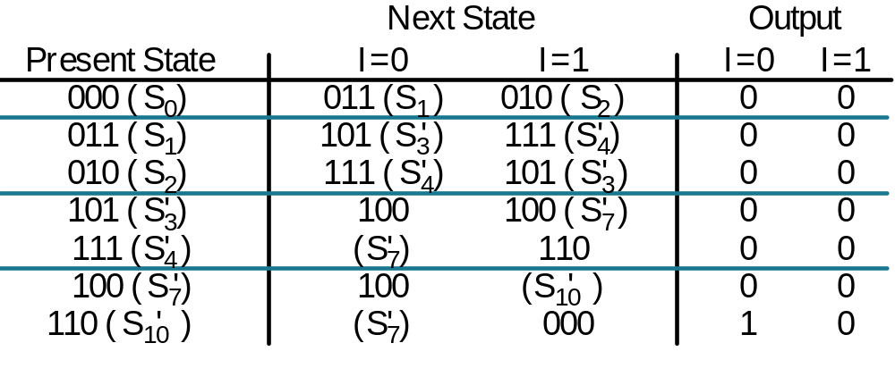
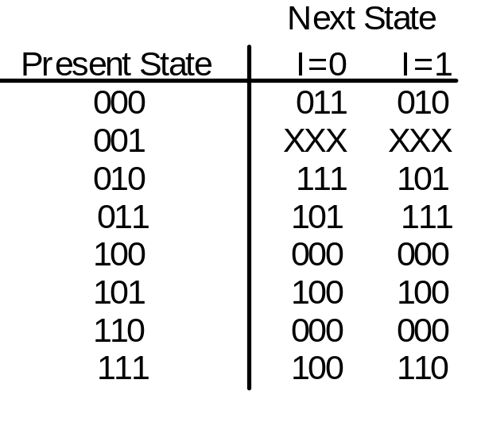
Choice of Flipflops
Examples
4 bit Sequence Detector using NOVA derived state assignment
Encoded State
Transition Table
Encoded Next
State Map

Slide 52
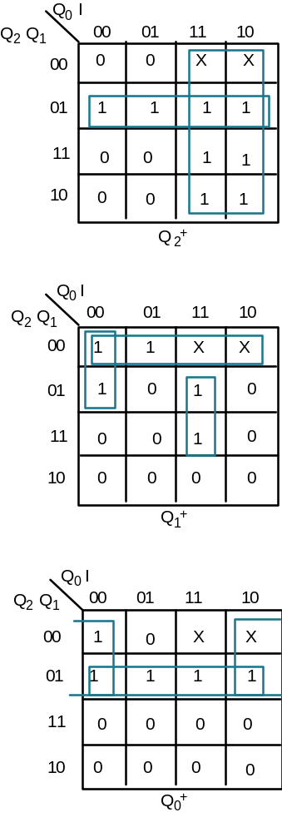
Choice of Flipflops
D FF Implementation
D = Q2•Q1 + Q0
Q2+
D = Q1 • Q0 • I + Q2 • Q0 • I + Q2 • Q1
Q1+
D = Q2 • Q1 + Q2 • I
Q0+
6 product terms
15 literals

Slide 53
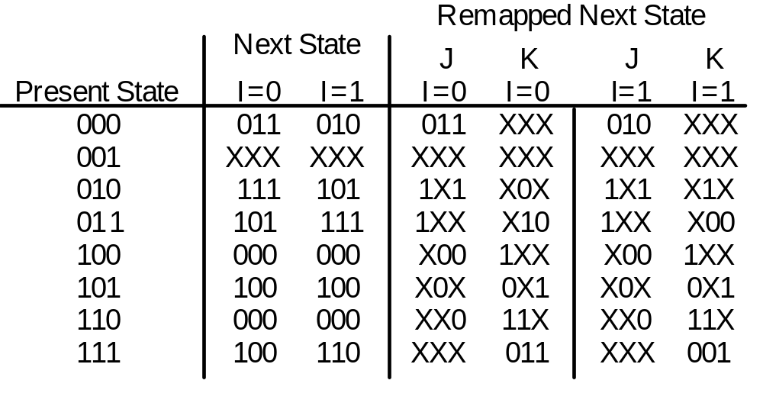
Choice of Flipflops
J-K Implementation
Remapped Next State Table

Slide 54
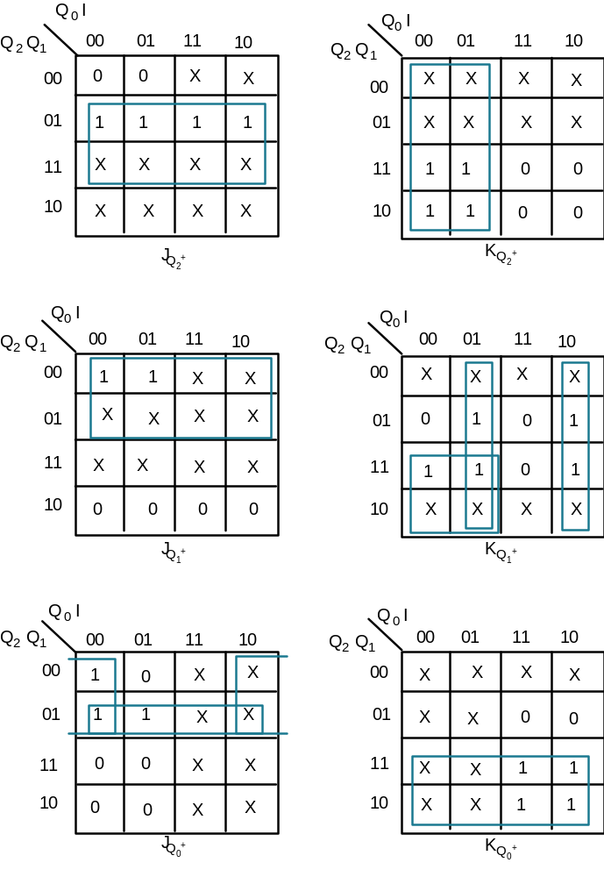
Choice of Flipflops
J-K Implementation (continued)
J = Q1
K = Q0
J = Q2
K = Q0 • I + Q0 • I + Q2 • Q0
J = Q2 • Q1 + Q2 • I
K = Q2
Q2+
Q2+
Q1+
Q1+
Q0+
Q0+
9 unique terms
14 literals

Slide 55
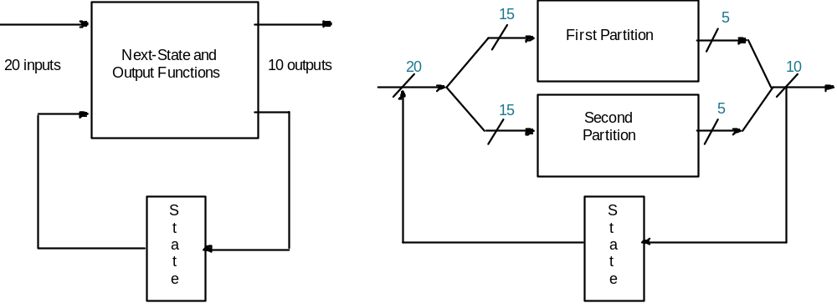
Finite State Machine Partitioning
Why Partition?
mapping FSMs onto programmable logic components:
limited number of input/output pins
limited number of product terms or other programmable resources
Example of Input/Output Partitioning:
5 outputs depend on 15 inputs
5 outputs depend on different overlapping set of 15 inputs

Slide 56
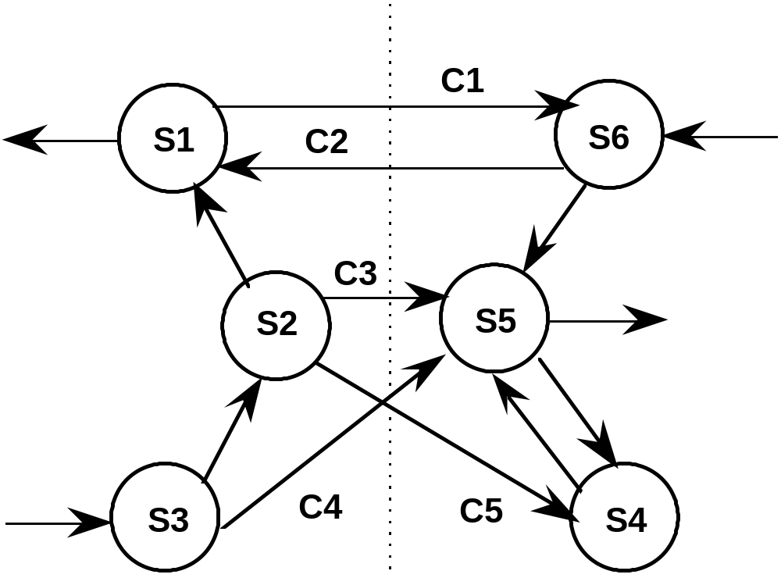
Finite State Machine Partitioning
Introduction of Idle States in the hope of reducing # of terms
In the next-state functions
Before Partitioning

Slide 57
Finite State Machine Partitioning
Introduction of Idle States
After Partitioning
C2•S6
C1
S6
C2•S6
SA
S1
C1•S1
C2
C3+C5
SB
C3•S2 +
S5
S2
C4•S3
C1•S1 + C3•S2 + C4•S3 + C5•S2
C5•S2
S4
C4
S3

Slide 58
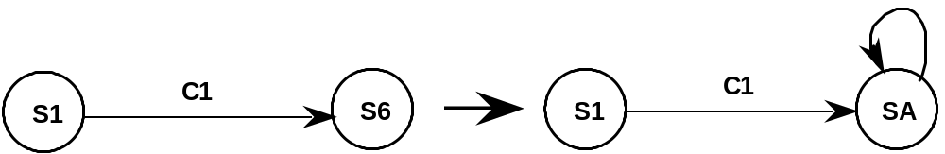
Finite State Machine Partitioning
Rules for Partitioning
Rule #1: Source State Transformation; SA is the Idle State
Rule #2: Destination State Transformation
C2
C2•S6
S1
S6
S1
SA

Slide 59
Finite State Machine Partitioning
Rules for Partitioning
Rule #3: Multiple Transitions with Same Source or Destination
C3
C3+C5
S5
S2
C3•S2 +
S5
S2
C4•S3
SA
SB
S3
C4
C5
S4
C4
S3
C5•S2
S4
Rule #4: Hold Condition for Idle State
C2•S6
C2•S6
S1
SA

Slide 60
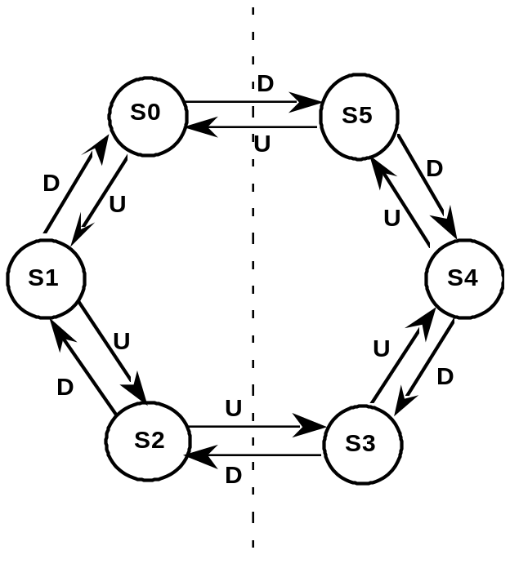
Finite State Machine Partitioning
Another Example
6 state up/down counter
building block has 2 FFs + combinational logic

Slide 61
Finite State Machine Partitioning
6 State Up/Down Counter
S0
S5
D
D
U•S5 + D•S3
D • S0
D
U
U
U
U • S5
S1
SA
SB
S4
U • S2
U
U
D • S3
U
D
D • S0 + U • S2
D
D
S2
S3
Introduction of the two idle state SA, SB
Count sequence S0, S1, S2, S3, S4, S5:
S2 goes to SA and holds, leaves after S5
S5 goes to SB and holds, leaves after S2
Down sequence is similar

Slide 62
Chapter Summary
Optimization of FSM
State Reduction Methods: Row Matching, Implication Chart
State Assignment Methods: Heuristics and Computer Tools
Implementation Issues
Choice of Flipflops
Finite State Machine Partitioning

